Slide 1
Westward Bound
The European Origins of
John and Eva Cheberenchick
Presented by Matrixa Research Group

Slide 2
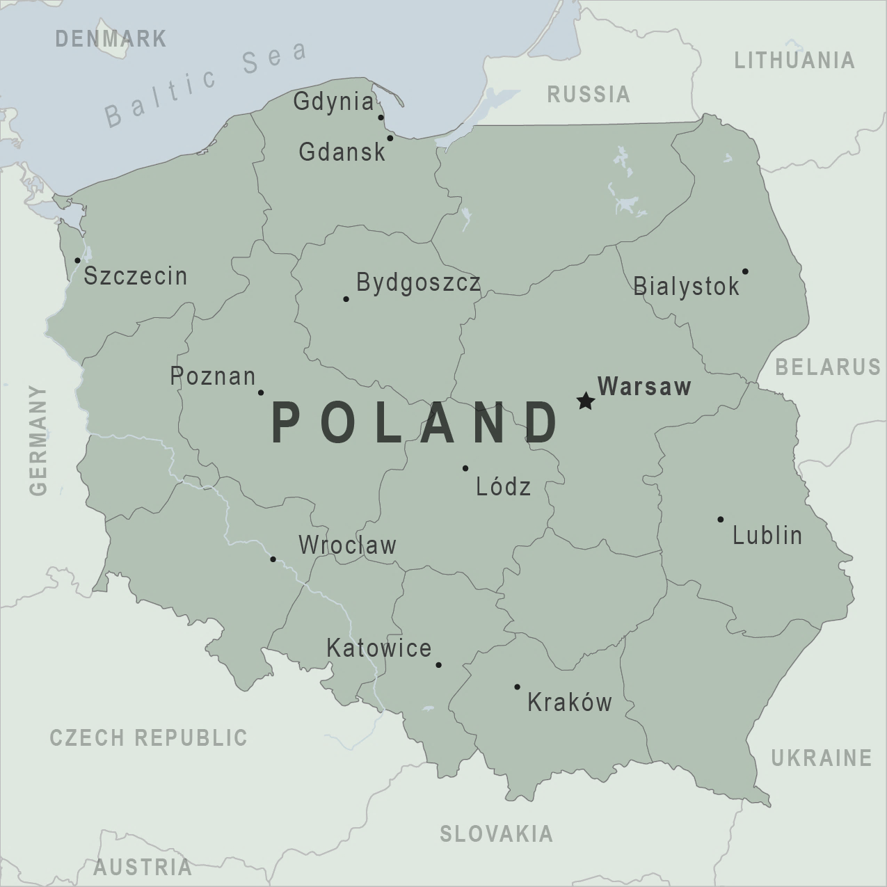
Research Notes
Research was conducted on the European origins of John & Eva Cheberenchick using primarily online genealogical databases and European history resources.
The objectives of this research were partially met. Further research is required to definitively identify what area and city both John and Eva grew up in and emigrated from.
Areas were identified across all source documents that reflected locations that would have been part of the Austrian-Hungarian Empire at the turn of the 20th century.
Today, these locations are located in the Southern Area of present-day Poland.

Slide 3
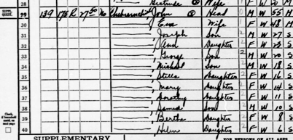
John & Eva Cheberenchick
Connections
John
Cheberenchick
Grandfather
Eva
Cheberenchick
Grandmother
1933 Naturalization Documents
1912 New Jersey State Marriage Index
1936 Naturalization Documents
1922 Naturalization Documents
1940 Federal Census
1930 Federal Census
1933 Naturalization Documents
1936 Federal Naturalization
Bertha
#####
Mother
1940 Federal Census
#####
#####
Son

Slide 4
John & Eva Cheberenchick
Timeline
1885
John Cheberenchick
is born
1900
John’s 1st Voyage
to the United States
1906
Eva’s 1st Voyage
to the United States
1912
John & Eva
Marry
1880
1915
1889-1892
Eva Cheberenchick
is born
1904
John’s 2nd voyage
to the United States
1909
Eva’s 2nd Voyage
to the United States

Slide 5
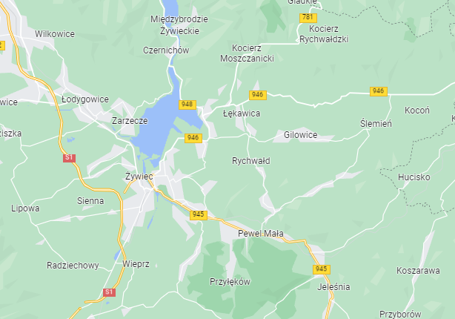
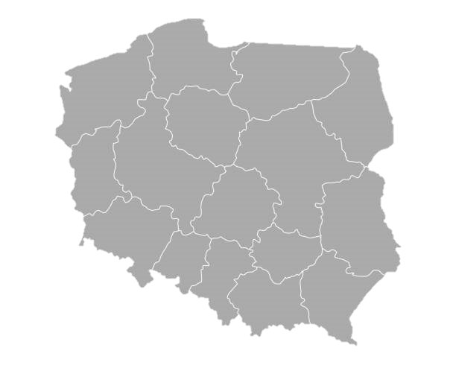
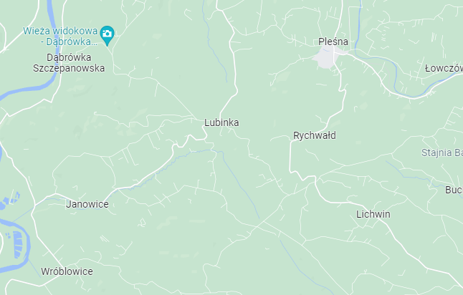
Galicia, Rychwald, Poland
Rychwald, Silesian Voivodeship (86km Southwest of Krakow)
WARSAW
KRAKOW
Rychwald, Lesser Poland (93km East of Krakow)

Slide 6
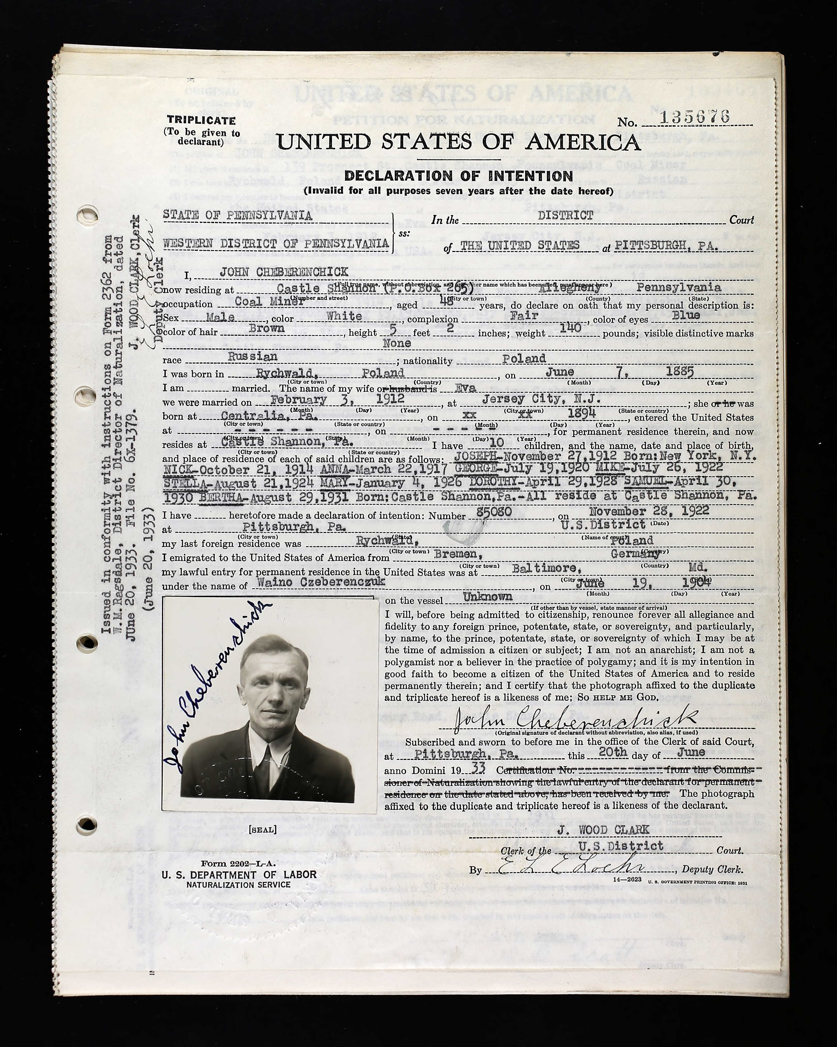
John Cheberenchick
Vital Record Data
Born: June 7th 1885
Place of Birth: Rychwald, Poland
Married: February 3rd 1912
Date of Entry: April 7th 1900
New York City
May 19th 1904
Baltimore, MD

Slide 7
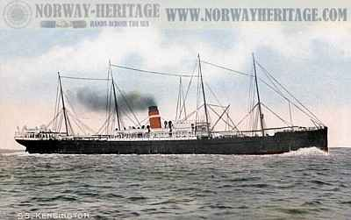
John Cheberenchick
S.S. Kensington (First Crossing)
Wanio Czeberenczyk
Noted Age: 36
Departing
Antwerp, Belgium
Arriving
New York, NY
April 7th 1900
Noted Place of Birth
Rychwald, Poland
This is the first reference of a Wanio Czeberenczyck in any western bound passenger lists, Wanio was noted as John’s name on his naturalization paperwork. While this could be our subject, age data does not match. Destination data does correlate with Eva’s eventual residence.

Slide 8
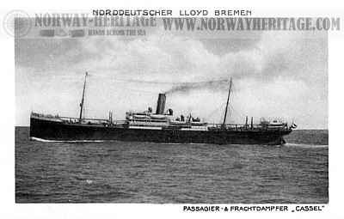
John Cheberenchick
S.S. Cassel (Second Crossing)
Wanio Czeberenczyk
Noted Age: 18
Departing
Bremen, Germany
May 19th, 1904
Arriving
New York, NY
June 2nd, 1904
Noted Place of Birth
Rychwald, Poland

Slide 9
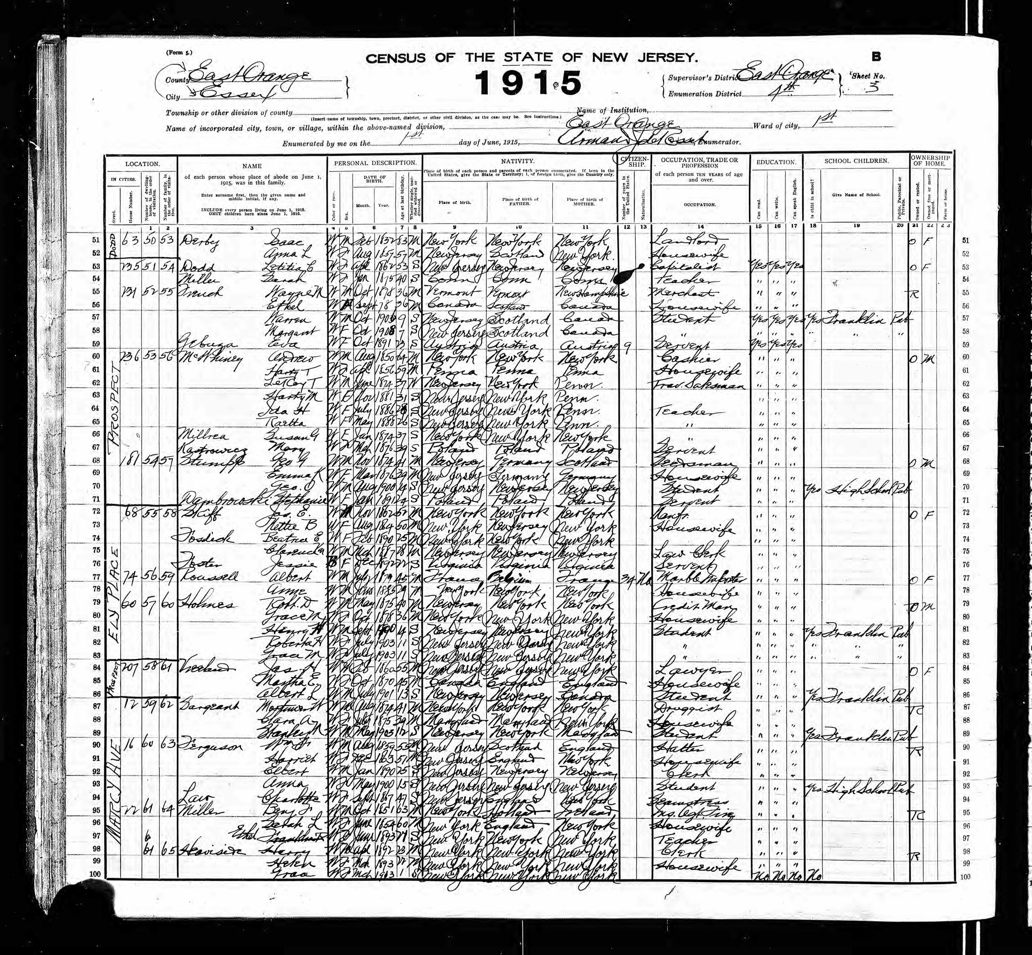
Eva Cheberenchick
Vital Record Data
Born: 1889-1892
Place of Birth: Rychwald, Galicia
Married: February 3rd 1912
Date of Entry: May 12th 1906
New York City
November 26th 1909
New York City

Slide 10
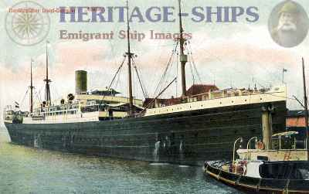
Eva Cheberenchick
S.S. Rhein (First Crossing)
Eva Gebusa
Noted Age: 17
Departing
Bremen, Germany
April 28th 1906
Arriving
New York, NY
May 12th 1906
Noted Residence
Rychwald

Slide 11
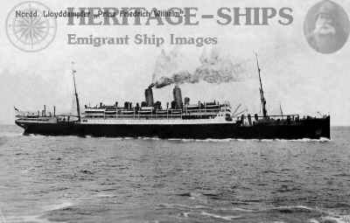
Eva Cheberenchick
S.S. Prince Friedrich Wilhelm
(Second Crossing)
Eva Gebusa
Noted Age: 18
Departing
Bremen, Germany
April 16th 1909
Arriving
New York, NY
Nov 26th 1909
Noted Residence
Galicia, Rychwald

Slide 12
Source
Slide 1 World Map courtesy of eTourism Summit
Slide 2 Map of Poland courtesy of the CDC
Slide 3 Map of Poland courtesy of istockphoto.com
Slides 5, 6, 8, and 9 ship photos courtesy of http://www.norwayheritage.com/
1915 N.J. State Census, East Orange County, New Jersey, Essex enumeration district 4th, sheet 3, Eva Gebusa: digital image ancestry.com (http://ancestry.com : accessed 10 April 2022); citing New Jersey State Archive Reference Number L-17, Film number 15.
1930 U.S. census, Alleghany County, Pennsylvania, population schedule, Castle Shannon Borough, enumeration district (ED) 13, sheet 7 B, dwelling 139, John Cheberenchick; digital image familysearch.org (http://www.familysearch.org : accessed 25 June 2021); citing NARA microfilm publication T626
1940 U.S. census, Alleghany County, Pennsylvania, population schedule, Castle Shannon Borough, enumeration district (ED) 2-539, sheet 7 B, dwelling 139, John Cheberenchick; digital image, familysearch.org (http://www.familysearch.org : accessed 25 June 2021); citing NARA microfilm publication T627.
Alleghany County, Pennsylvania, death certificate no. 090819-62, John Cheberenchick; Pennsylvania Historic and Museum Commission, Harrisburg. Ancestry.com (https://www.ancestry.com : accessed 25 April 2022)
“Austrian Poland (Galicia) Austro-Hungarian Empire Genealogy” FamilySearch Wiki, 21 April 2022 (https://www.familysearch.org/en/wiki/Austrian_Poland_(Galicia),_Austro-Hungarian_Empire_Genealogy: accessed 25 April 2022)
Baltimore, Maryland, U.S Passenger Lists” database, Ancestry (http://www.ancestry.com : accessed 25 April 2022), entry for Wanio Czeberenczyk, age 18, arrived Baltimore, 1904, S.S. Cassel; citing NARA microfilm publication T844.
Galicia Historical Region Eastern Europe,” Encyclopedia Britannica, 20 July 1998 (https://www.britannica.com/place/Galicia-historical-region-Eastern-Europe: accessed 05 May 2022)
Kenneth Checque (San Antonio, Texas), phone interview with Josh Robishaw (Chantilly, Virginia) re: family history of John and Eva Cheberenchick, 27 March 2021; electronic notes held by Josh Robishaw, “KC2021.docx,” in client file “Checque.”

Slide 13
Sources
New Jersey, U.S. Marriage Index, [vol. D-G], p 350, Eva Gebuza-Joh Cheberenczyk, 1912; image, New Jersey State Archives, Trenton, NJ, State Archives, 1910-1914, (https://www.ancestry.com : accessed 25 April 2022)
“New York, U.S Arriving Passenger and Crew Lists” database, Ancestry (http://www.ancestry.com : accessed 25 June 2021), entry for Wanio Czeberenczyk, age 36, arrived New York City, 1900, S.S. Kensington; citing NARA microfilm publication T715.
“New York, U.S Arriving Passenger and Crew Lists” database, Ancestry (http://www.ancestry.com : accessed 25 April 2022), entry for Eva Gebusa, age 17, arrived New York City, 1906, S.S. Rhein; citing NARA microfilm publication T715.
“New York, U.S Arriving Passenger and Crew Lists” database, Ancestry (http://www.ancestry.com : accessed 25 April 2022), entry for Ewa Gebusa, age 18, arrived New York City, 1909, S.S. Prince Friedrich Willhelm; citing NARA microfilm publication T715.
The National Archives at Philadelphia, Pennsylvania, Western District. U.S. Federal Naturalization Records 1795-1931. Records of District Courts of the United States. National Archives – Philadelphia, Pennsylvania. Ancestry.com (https://www.ancestry.com : accessed 25 April 2022)
The National Archives at Philadelphia, Pennsylvania, Western District. U.S. Federal Naturalization Records 1795-1931 Petition Numbers 103226-103500. Records of District Courts of the United States. National Archives – Philadelphia, Pennsylvania. Ancestry.com (https://www.ancestry.com : accessed 25 April 2022)
U.S. District Court, Pennsylvania, Western District. U.S. Federal Naturalization Records 1797-1931. Record Group 21: Records of District Courts of the United States. National Archives – Washington, D.C. Ancestry.com (https://www.ancestry.com : accessed 25 April 2022)

Slide 14
Research conducted and developed by
Matrixa Research Group
© Matrixa Research Group 2022

